Slide 1

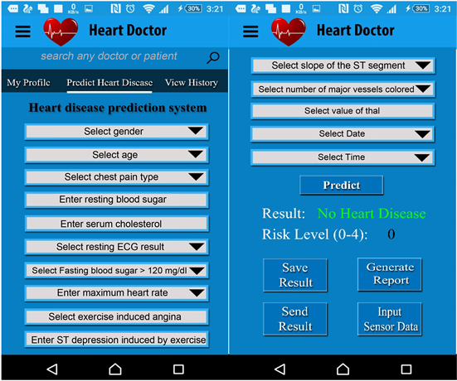
VIGNAN’S INSTITUTE OF INFORMATION TECHNOLOGY (A):: DUVVADA,VISAKHAPATNAM
Department of Computer Science and Engineering
CSE-2 :: Batch No : B-15
Project Title
Diagnosis of Disease (Heart diagnosis site)
2018-2022 Batch B.Tech Mini Project
NAME | Register Number | ROLE
DR G.RAJENDRA | ----------------- | Guide
M.A SHANAWAZ | 18L31A05E0 | Team Lead
P.HANISHA | 18L31A05H0 | Team Member
K.K MAHEEDHAR | 18L31A05F3 | Team Member
G.PAVAN KUMAR | 18L31A05D6 | Team Member
This Photo by Unknown Author is licensed under CC BY

Slide 2
ABSTRACT OF DISEASE DIAGNOSIS
There may be an ambiguity for the people(doctors) to classify the severity of certain disease, according to the severity certain aid should be given ,which may reduce the effort or expensive cost for the both customer and client.
By using certain features of a particular disease we can classify the severity of the particular disease, by using some classification algorithms like Logistic Regression, Naïve Bayes, Stochastic Gradient Descent, K-Nearest Neighbours, Decision Tree, Random Forest, Support Vector Machine, Neural Networks. by creating an efficient algorithm we can classify the aid or precautions required for the current stage of the disease affected.
We also provide an interactive UI for the users to use and enter the features of the particular disease they want to know so that they can be aware and decide the next step, as this application can be used in an emergency.
We will use the best framework and optimal algorithms to speed up the execution time.

Slide 3
Abstract of Heart Diagnosis Site (HDS).
Every day, the average human heart beats around 100,000 times, pumping 2,000 gallons of blood through the body. Inside your body there are 60,000 miles of blood vessels.
The signs of a woman having a heart attack are much less noticeable than the signs of a male. In women, heart attacks may feel uncomfortable squeezing, pressure, fullness, or pain in the center of the chest. It may also cause pain in one or both arms, the back, neck, jaw or stomach, shortness of breath, nausea and other symptoms. Men experience typical symptoms of heart attack, such as chest pain , discomfort, and stress. They may also experience pain in other areas, such as arms, neck , back, and jaw, and shortness of breath, sweating, and discomfort that mimics heartburn.
Heart burnings and little pains are part of the daily life, we cannot predict the stability of the heart until the severe stage,ignorance and irregularity we definitely affect your heart.

Slide 4
But the aritficial intellegence had made this work a little bit easier we can predict the likely outcomes of one may have heart disease by using some simple features.
By embedding our HDS classification model with a web application every one can you this with ease and the data which is used to train the model is very large, the accurancy will be more.

Slide 5
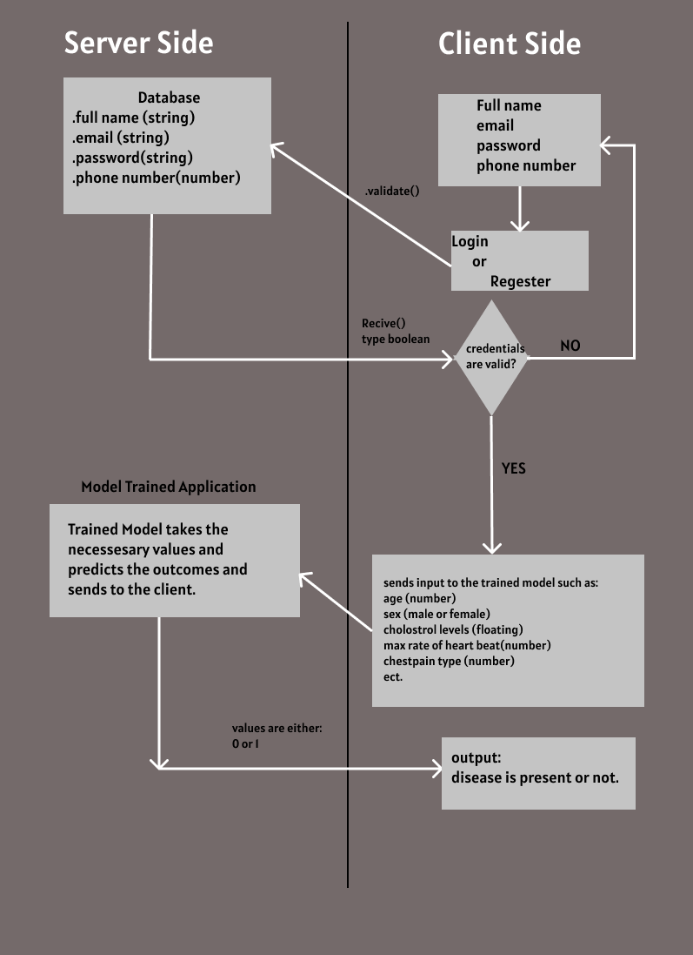
OOP Diagram for our HDS

Slide 6
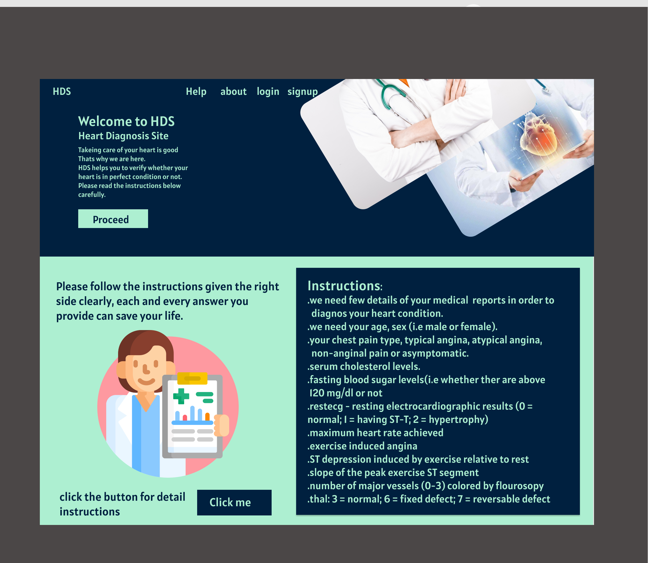
Sample Preview of our HDS Heart Diagnosis Site

Slide 7







Techonology Stacks
Angular
Python
HTML
GO Lang
Type Script

Slide 8
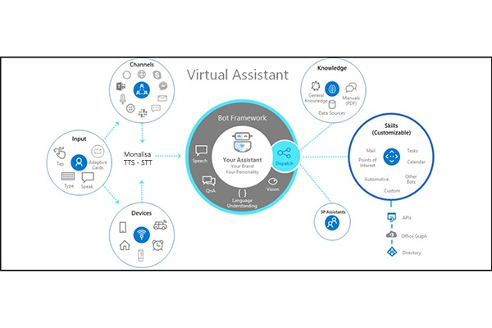
System Requirments
Client Side:
Any android or Ios os
Windows 7+ versions
Internet browser which supports HTML 5
Ram: atleast 500mb
Server Side:
Databases which support sql or noSql servers
Systems must contain atleast 500gb storage,
Ram: atleast 4gb,
GPU optional

Slide 9
Thank You. Stay Safe, Stay Healthy

